Slide 1

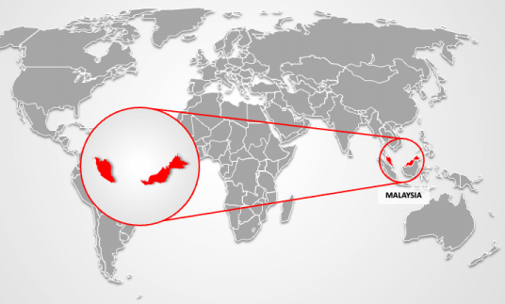
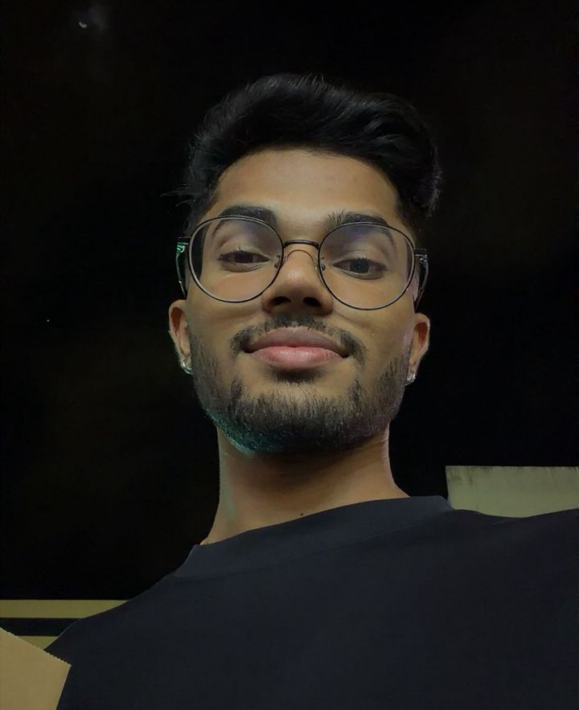




TIRTHAH DEV PILLAI A/L SATHURAMAN
University: Universiti Malaysia Pahang Al-Sultan Abdullah
Study program: Mechatronics Engineering
Year of study: 4th Year
City: Pahang, Malaysia
Motto for life: Good things take time
Hobbies: Watching F1, playing sports (Taekwondo and football), and attending concerts.
Your expectations from the summer school:
Learn from the world, connect beyond borders, and create a more sustainable future.
Location where I study,
and I live
Karlsruhe
31 August to 11 September 2026

